Slide 1
Kinematics Presentation Tom
3_27_25

Slide 2
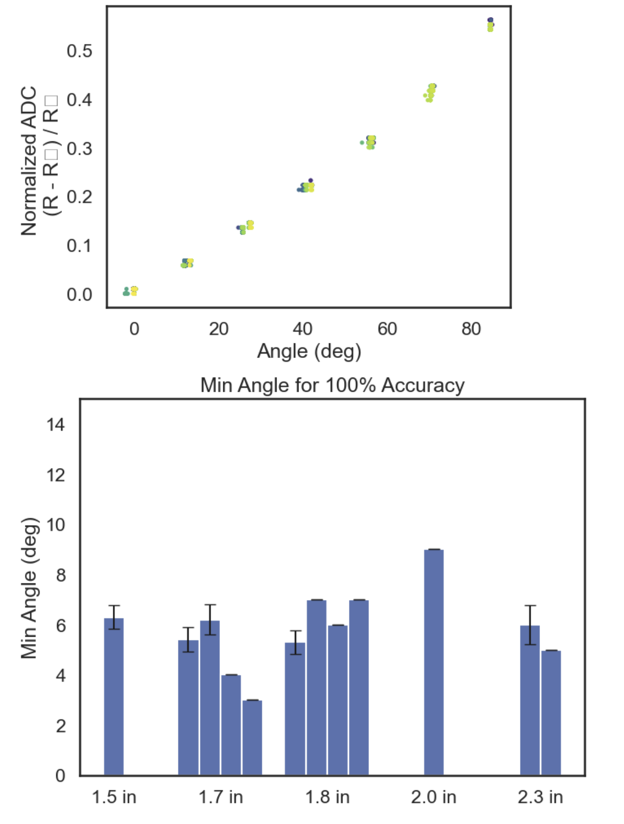
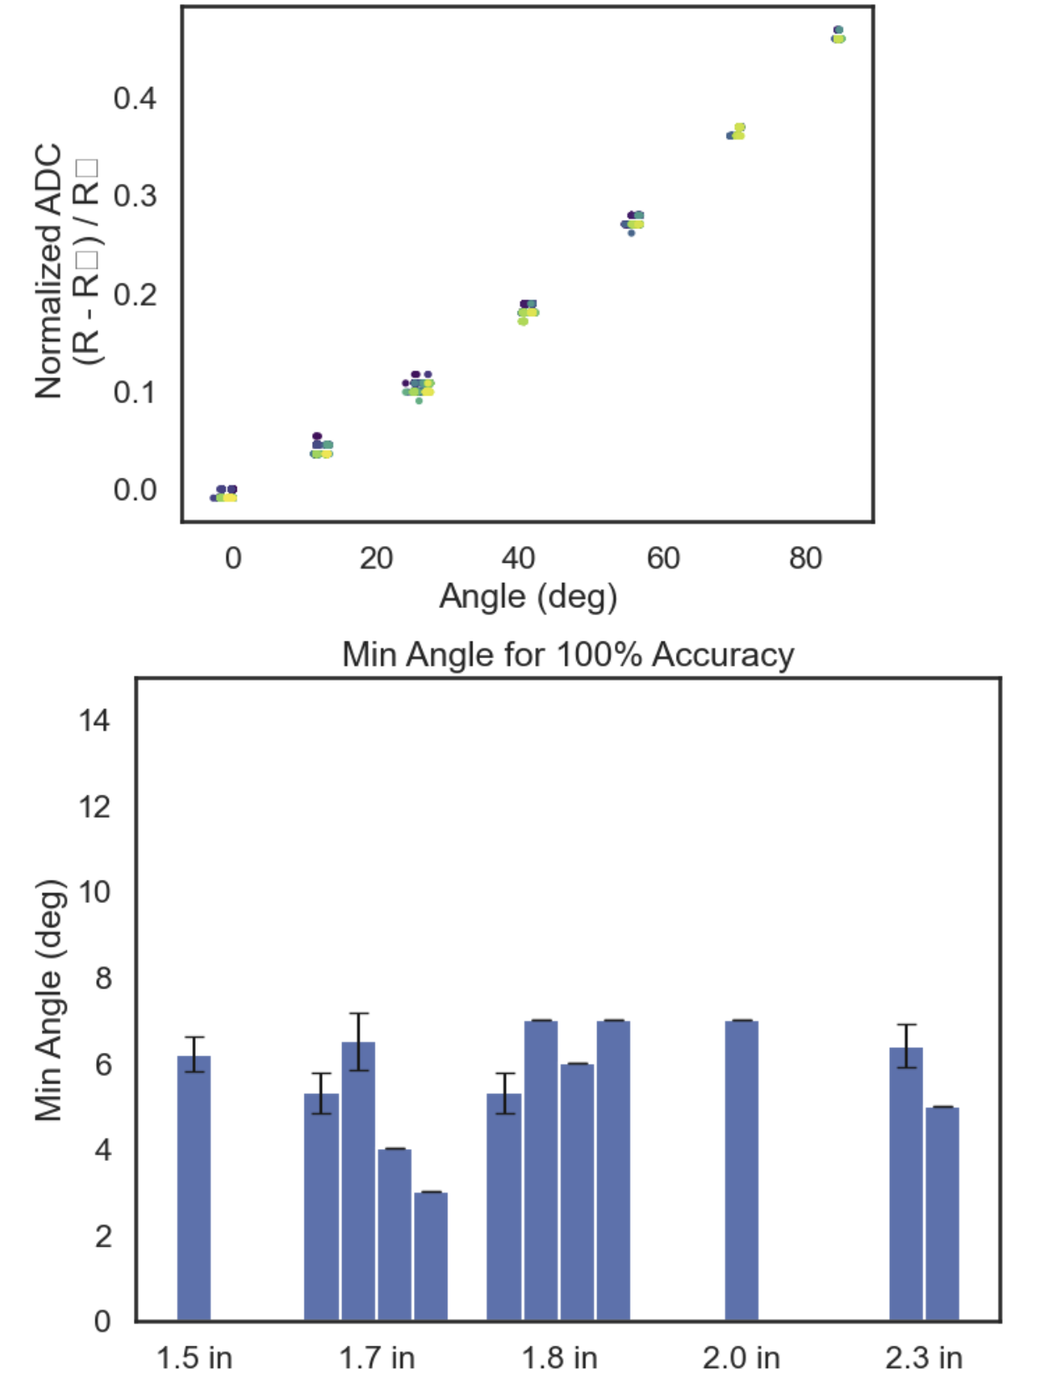
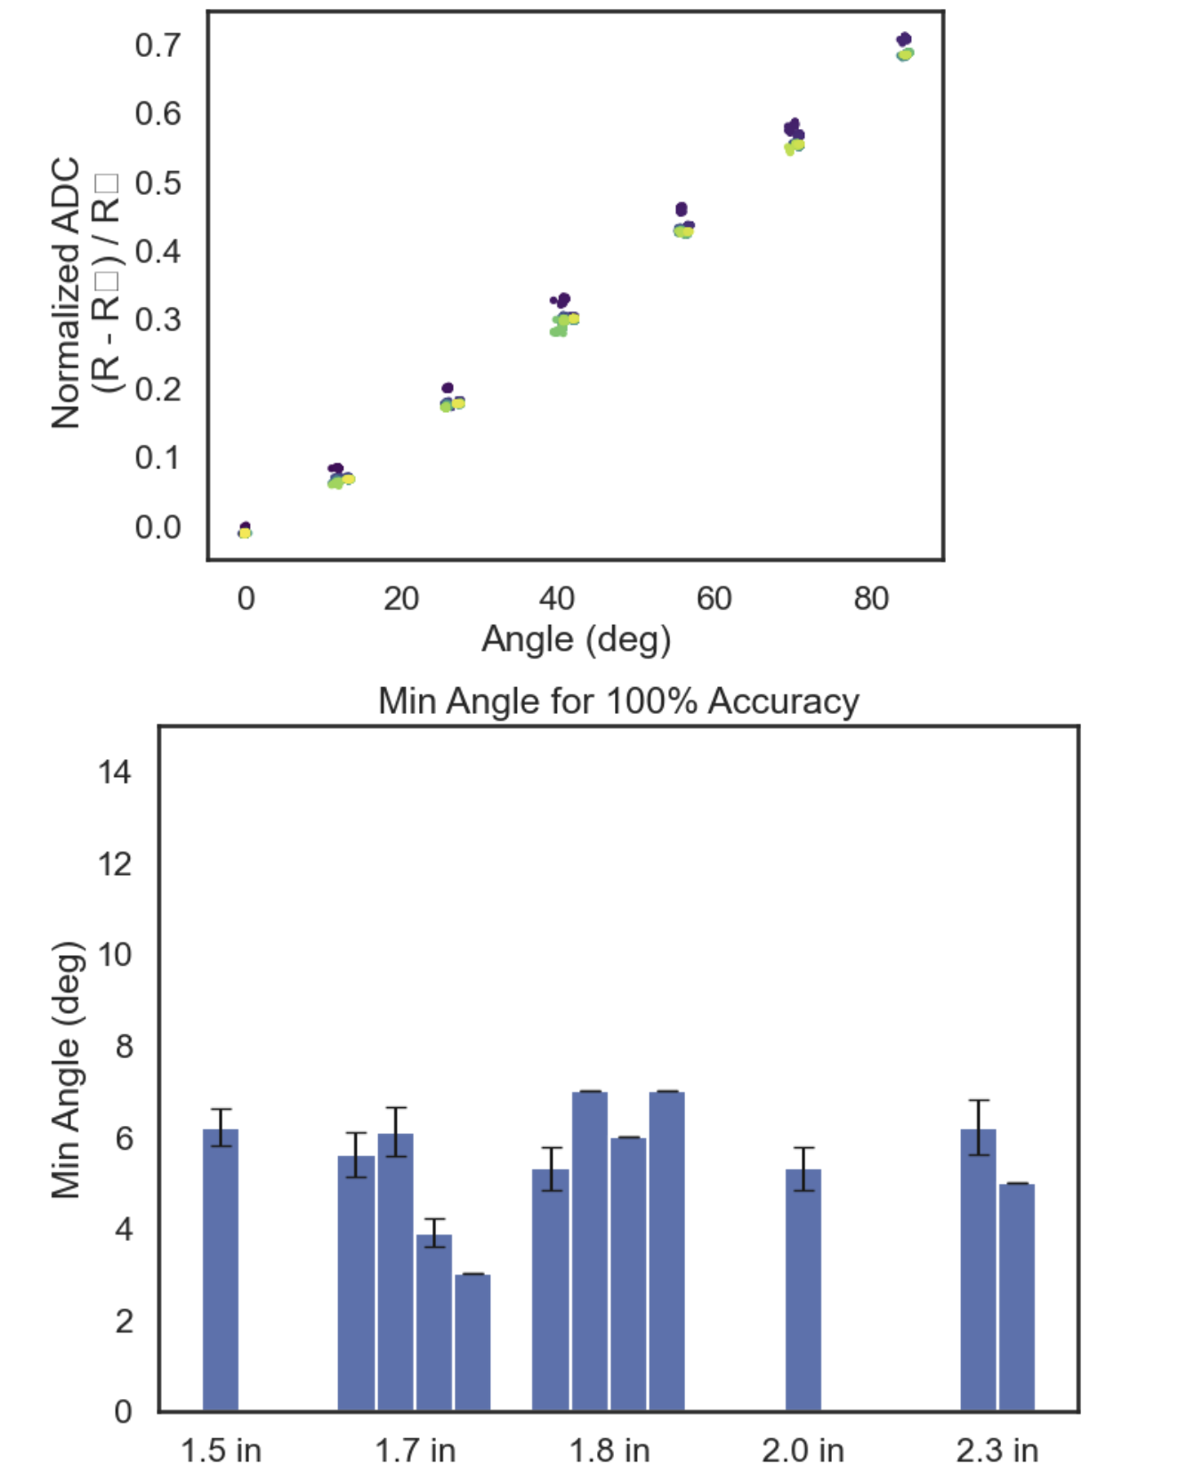
~0.67V source, 16 bit enc, 8x ADC gain, 100 ohm div
Just Re-testing previous
3.3V source, 16 bit enc, 8x ADC gain, 50 ohm div

Slide 3
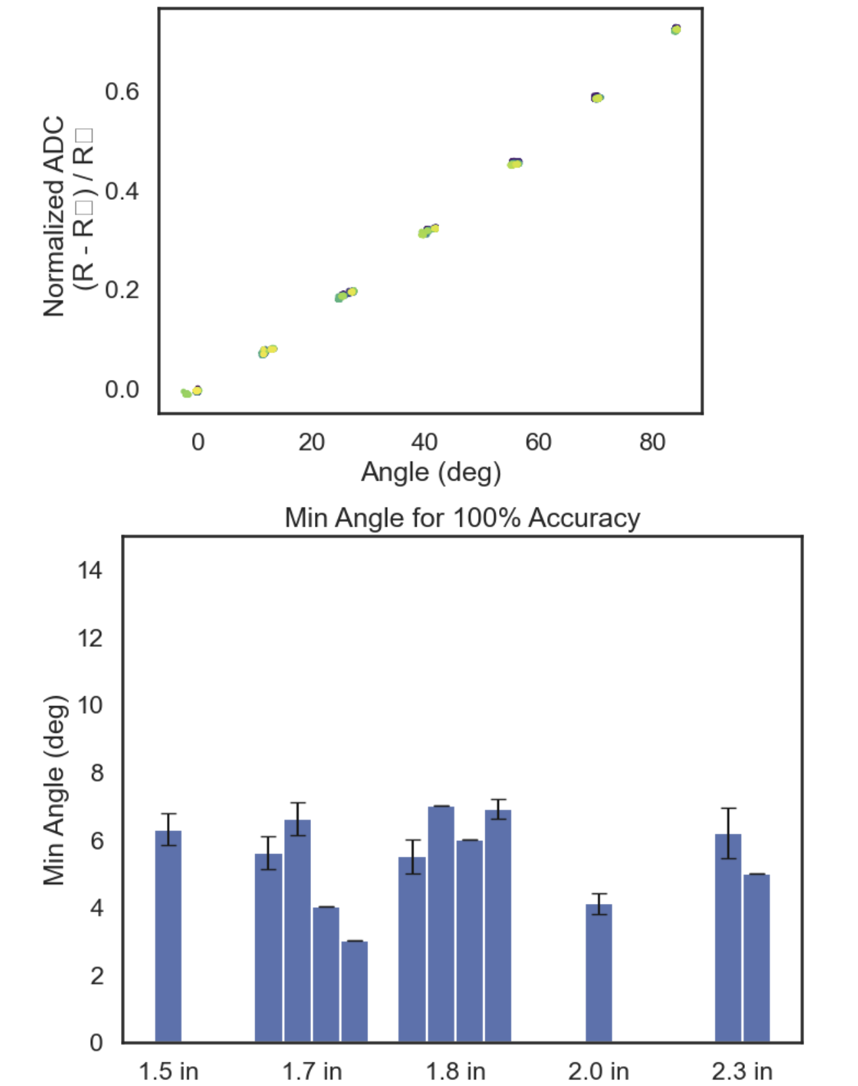
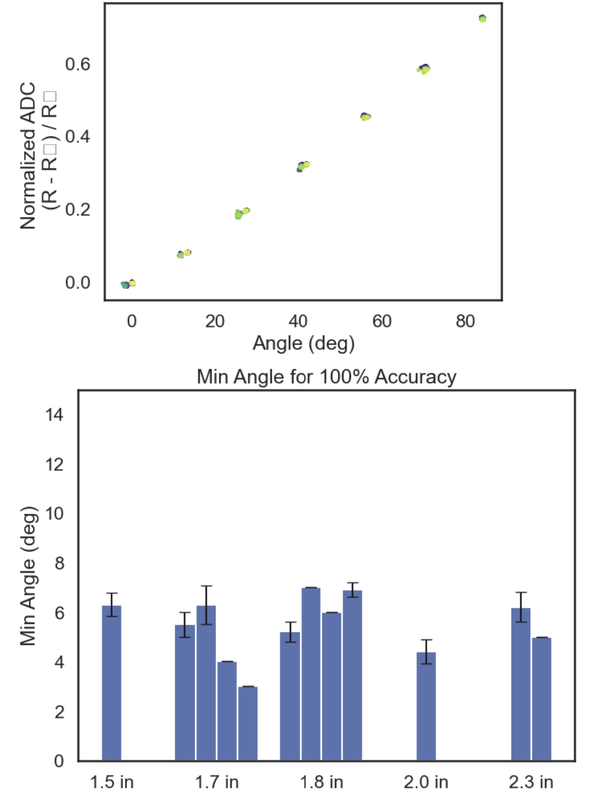
3.3V source from LVR and 2 x 10uF Caps, 16 bit enc, 8x ADC gain, 50 ohm div
3.3V source from LVR and 2 10uF Caps, 16 bit enc, 8x ADC gain, 40 ohm div (~15% of possible ADC range)
3.3V source, 16 bit enc, 8x ADC gain, 50 ohm div

Slide 4
Kinematics Presentation Tom
4_9_25

Slide 5
Circuit Testing Summary
AD620 Instrumentation Amplifier Successfully configured to amplify the differential signal across the strain gauge and 2.048V Vref
LMC6840 Op-Amp Used to amplify the strain gauge voltage in a single-ended configuration. Provided stable output with low noise under 3.3V single-supply operation.
Power Supply Tried both 5V and 3.3V Low-Voltage Regulator (LVR)
Working Circuit Among several configurations tested, only one circuit demonstrated consistent and reliable performance. This setup will be the focus of further discussion and documentation.

Slide 6
Circuit V1 Option
50 ohm
Strain Gauge (0.4 ohm – 0.8ohm)
LVR +3.3V
+26 mV to 52 mV
+0 mV
GND
x76
LMC6482, 75kohm/1kohm, total gain of 76
LM040, 2.048V ref
GND
+1.98 V to 3.95V
-2.048 V
x2
MCP3421 Differential Input PGA x2, 16 bit
(Alternative can use ADS111)
Arduino Uno I2C
ADC bits range from ~ -3000 to 20000 (as opposed to 5000 delta previously) of possible -32k to 32 k

Slide 7
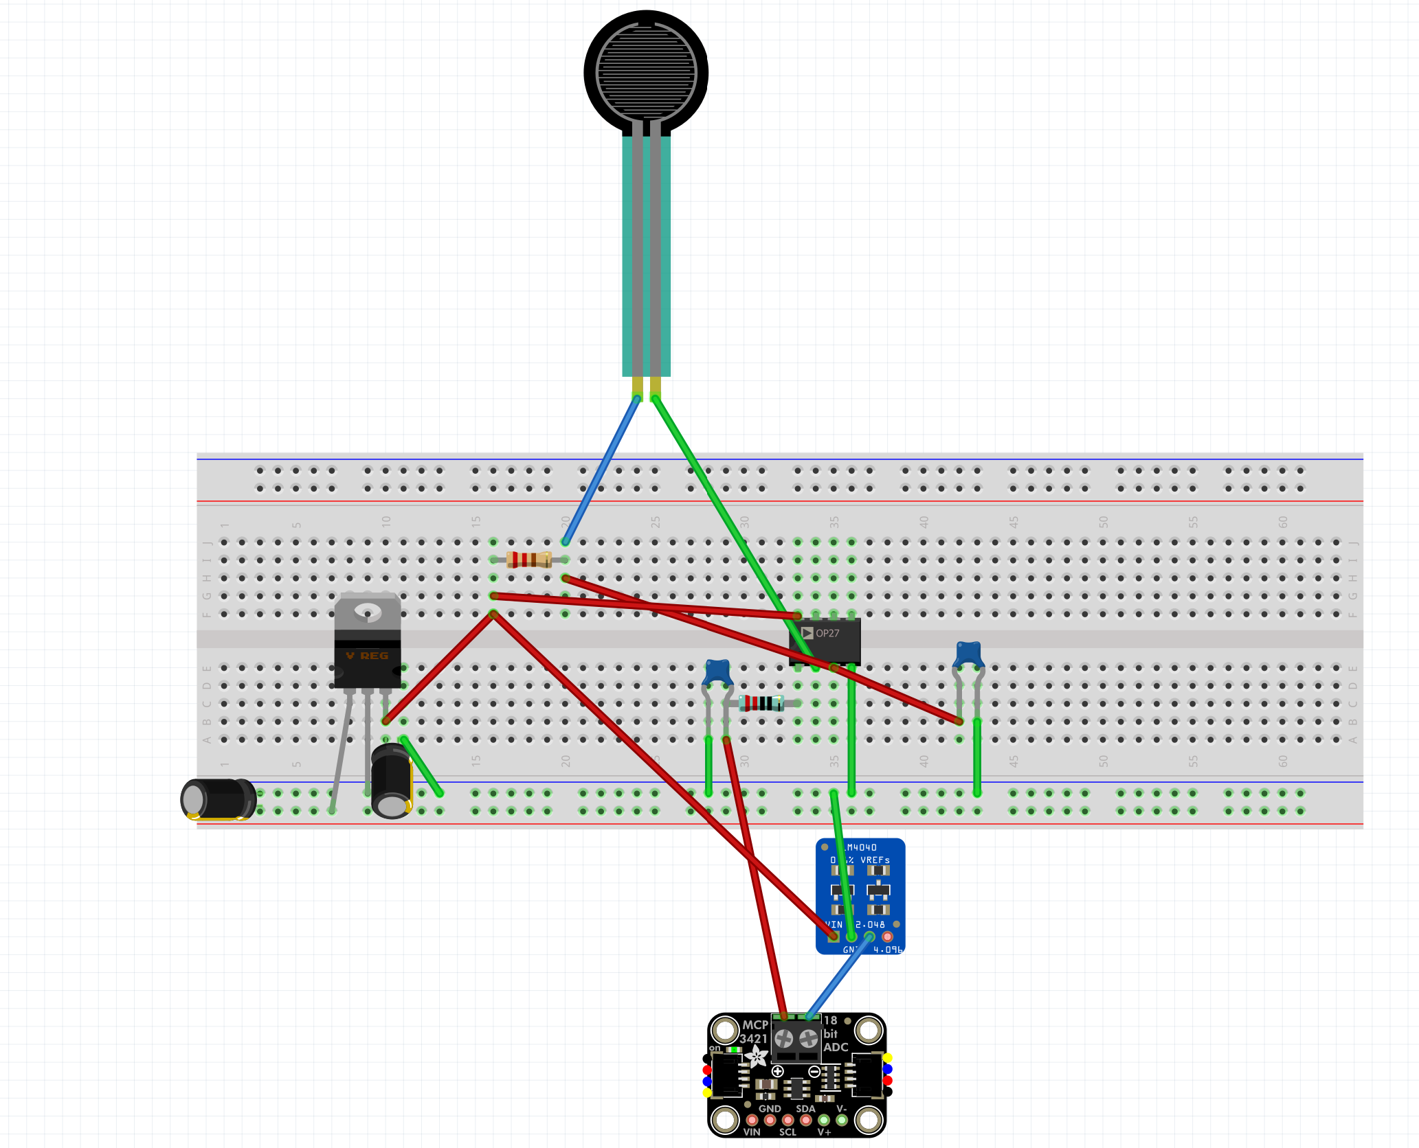
Latest circuit does NOT have any RF filtering on opamp output
Actual Strain gauge about a foot away from this circuit
1 uF
1k ohm
50 ohm
LVR 3.3 V from 5V Arduino Uno
10 uF
0.1 uF
5V Arduino uno source

Slide 8
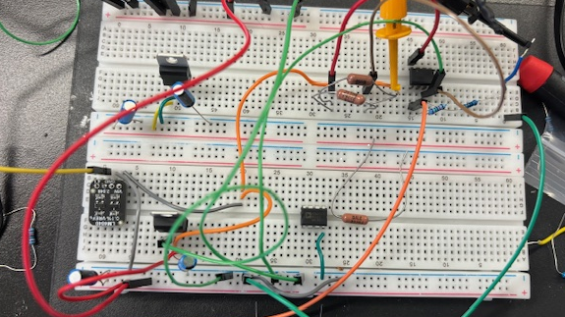

Slide 9
Circuit V2 Option (IDEAL)
Strain Gauge (0.4 ohm – 0.8ohm)
1kohm (to limit current)
2.048V Vref
GND
+1.3 mV to 2.6 mV + Vref
~ - 1.95 mV (order precision resistor for this)+ Vref (average of input voltage range)
LVR +3.3V
X?
ADS112C04 or NAU7802 16-Bit, 4-Channel, 2-kSPS, Delta-Sigma ADC With I2C Interface, 128x Gain!
GND
Microcontroller
Using Differential ADC for Common Mode Rejection
NAU7802 Already does this but my output was very noisy!

Slide 10
NAU7802 – use external 3.3V LVR and 2.048V ref (or slightly more) for AN- and 2.048V + strain gauge voltage for AN+
Serial.print("LDO voltage set to ");
switch (nau.getLDO()) {
case NAU7802_4V5: Serial.println("4.5V"); break;
case NAU7802_4V2: Serial.println("4.2V"); break;
case NAU7802_3V9: Serial.println("3.9V"); break;
case NAU7802_3V6: Serial.println("3.6V"); break;
case NAU7802_3V3: Serial.println("3.3V"); break;
case NAU7802_3V0: Serial.println("3.0V"); break;
case NAU7802_2V7: Serial.println("2.7V"); break;
case NAU7802_2V4: Serial.println("2.4V"); break;
case NAU7802_EXTERNAL: Serial.println("External"); break;

Slide 11
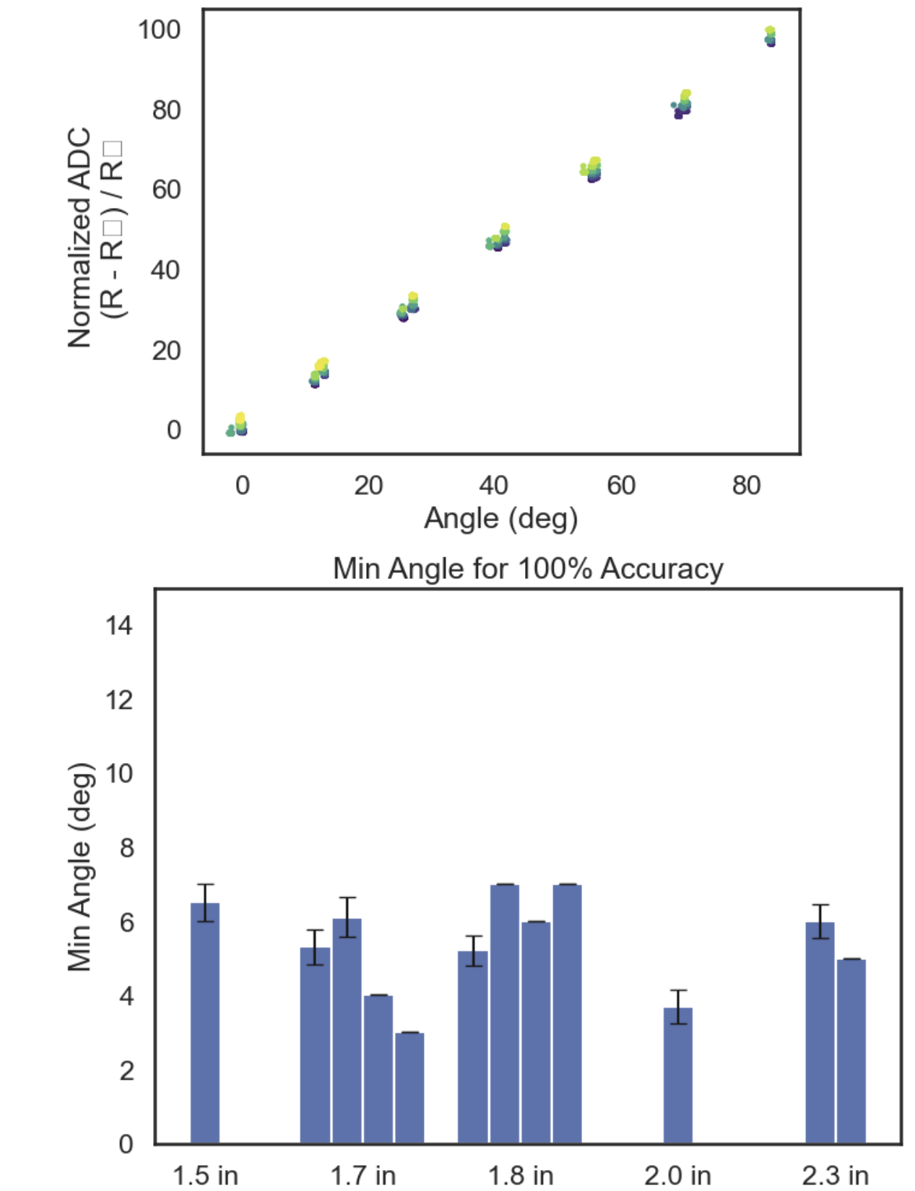
3.3V source from LVR and 2 x 10uF Caps, 16 bit enc, 8x ADC gain, 50 ohm div
3.3V source from LVR and 2 x 10uF Caps, 16 bit enc, 2x ADC gain (using diff input), 76x gain from LMC6482 (across gauge), 50 ohm div with 0.4 ohm strain gauge (see circuit)
Bc of breadboarding, distance from strain gauge to circuit over a foot

Slide 12
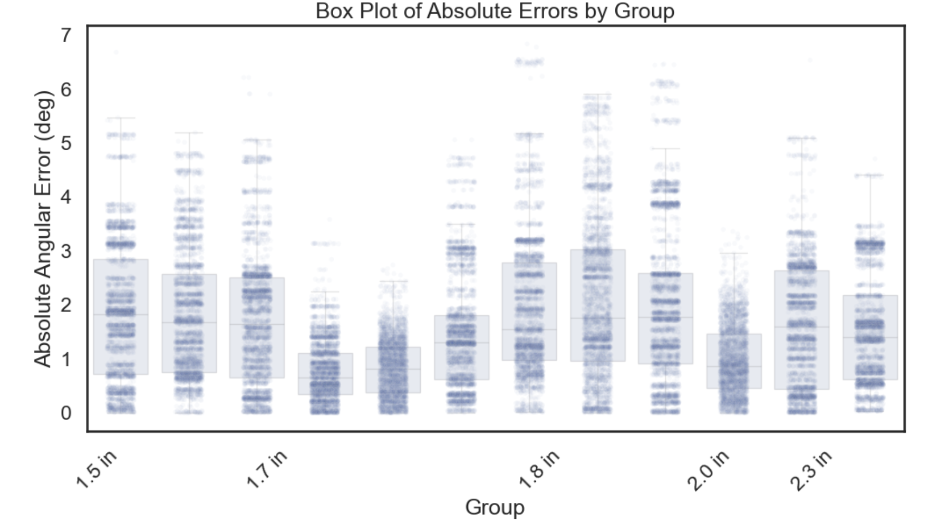

Slide 13
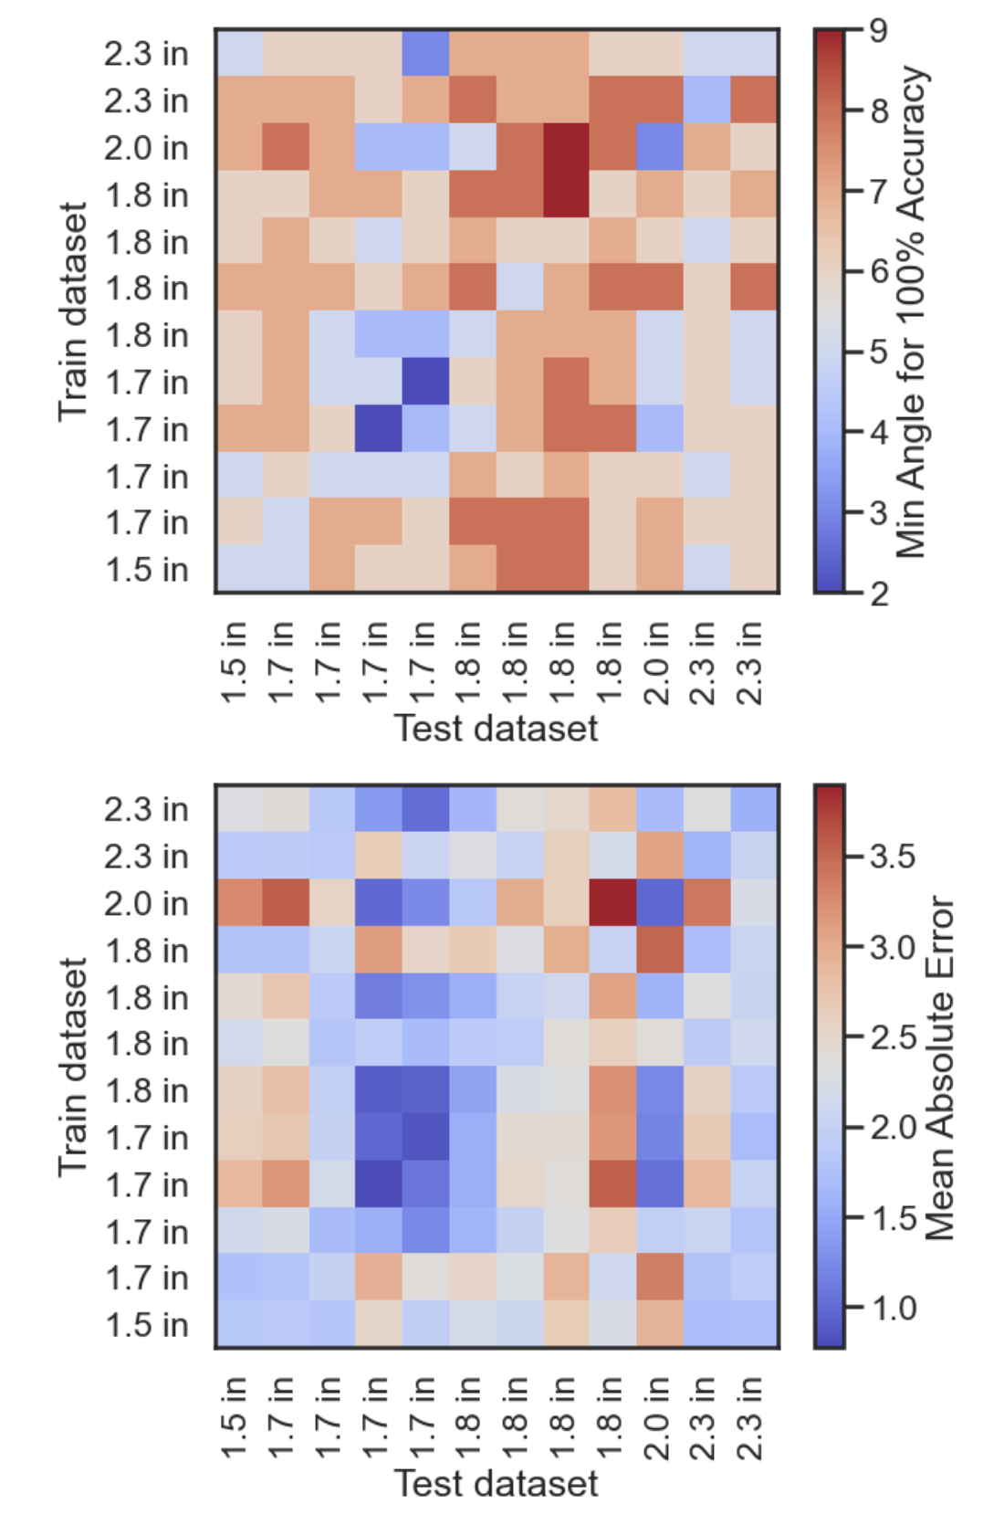

Slide 14
Circuit V2 Option (IDEAL)
Strain Gauge (0.4 ohm – 0.8ohm)
1kohm (to limit current)
2.048V Vref
GND
+1.3 mV to 2.6 mV + Vref
~ - 1.95 mV + Vref (average of input voltage range)
LVR +3.3V
X?
ADS112C04 16-Bit, 4-Channel, 2-kSPS, Delta-Sigma ADC With I2C Interface, 128x Gain!
GND
Microcontroller
Using Differential ADC for Common Mode Rejection

Slide 15
Kinematics Presentation Tom
4_17_25

Slide 16
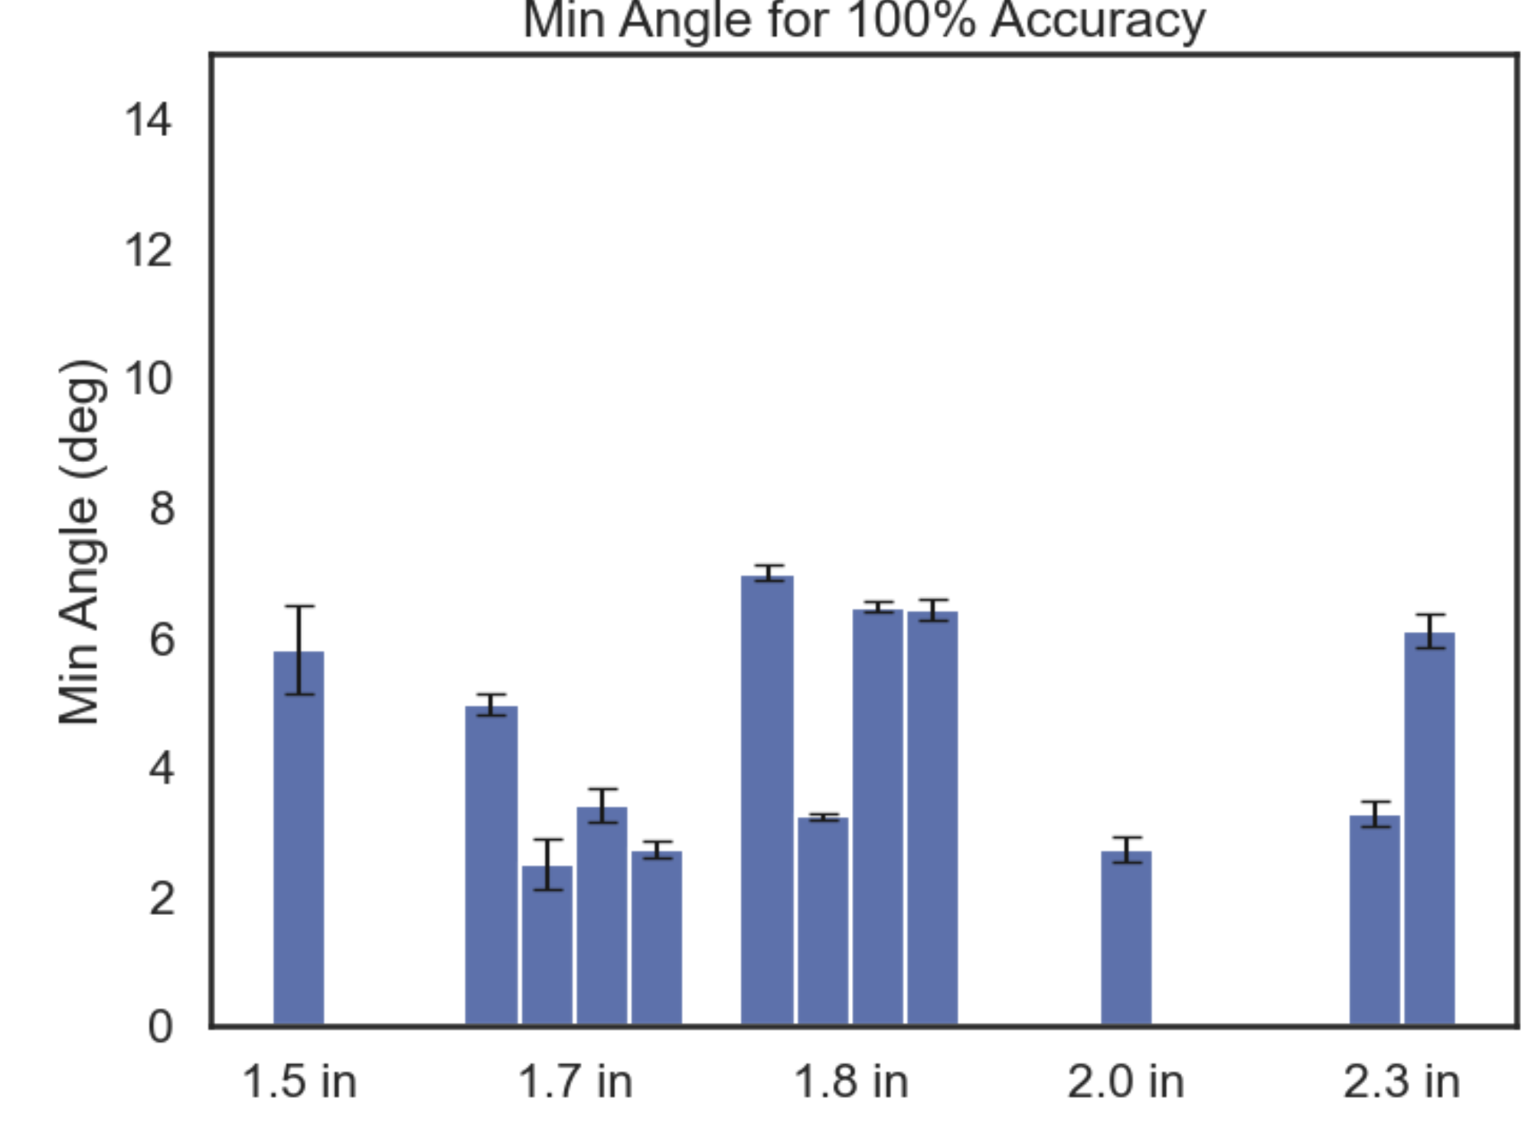
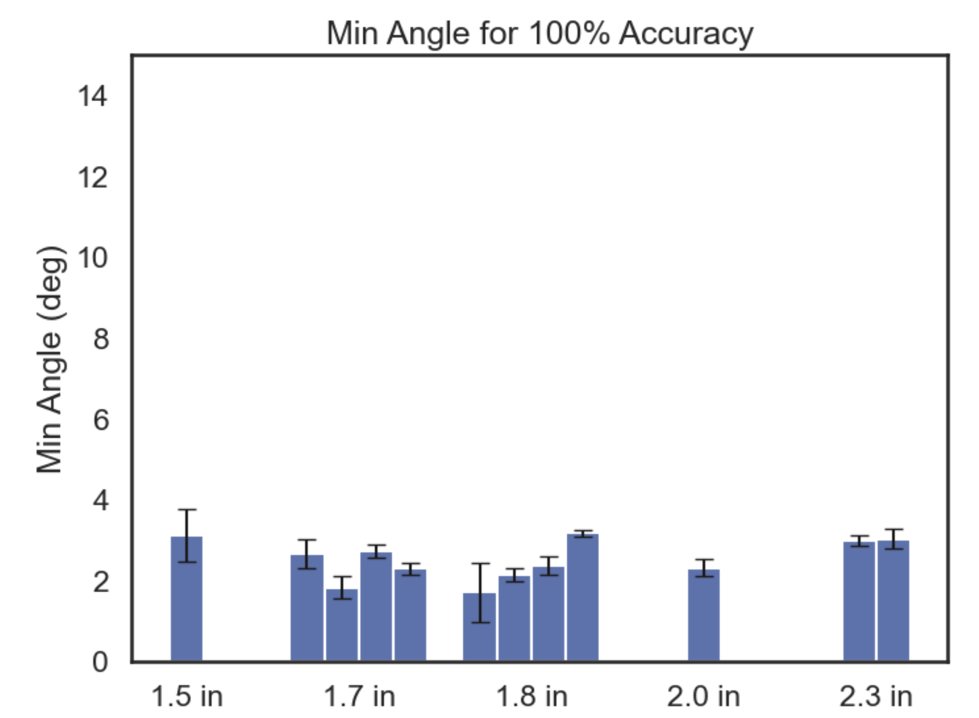
Linear Fitting
Quadratic Fitting
Red Boxes = tests using full pos ADC range

Slide 17
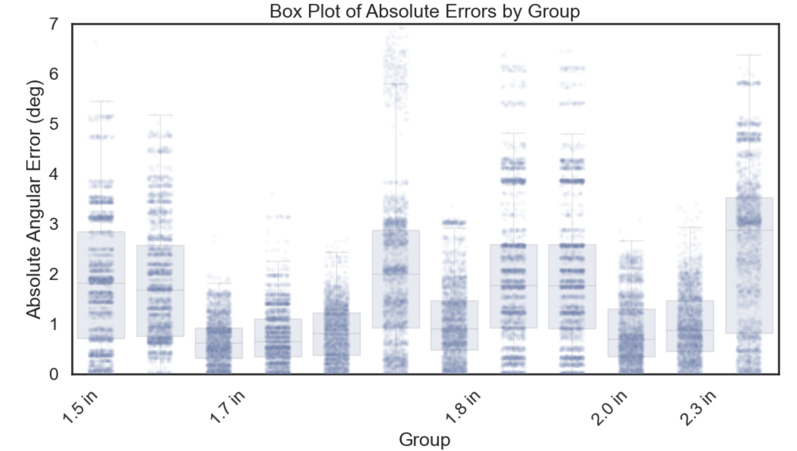
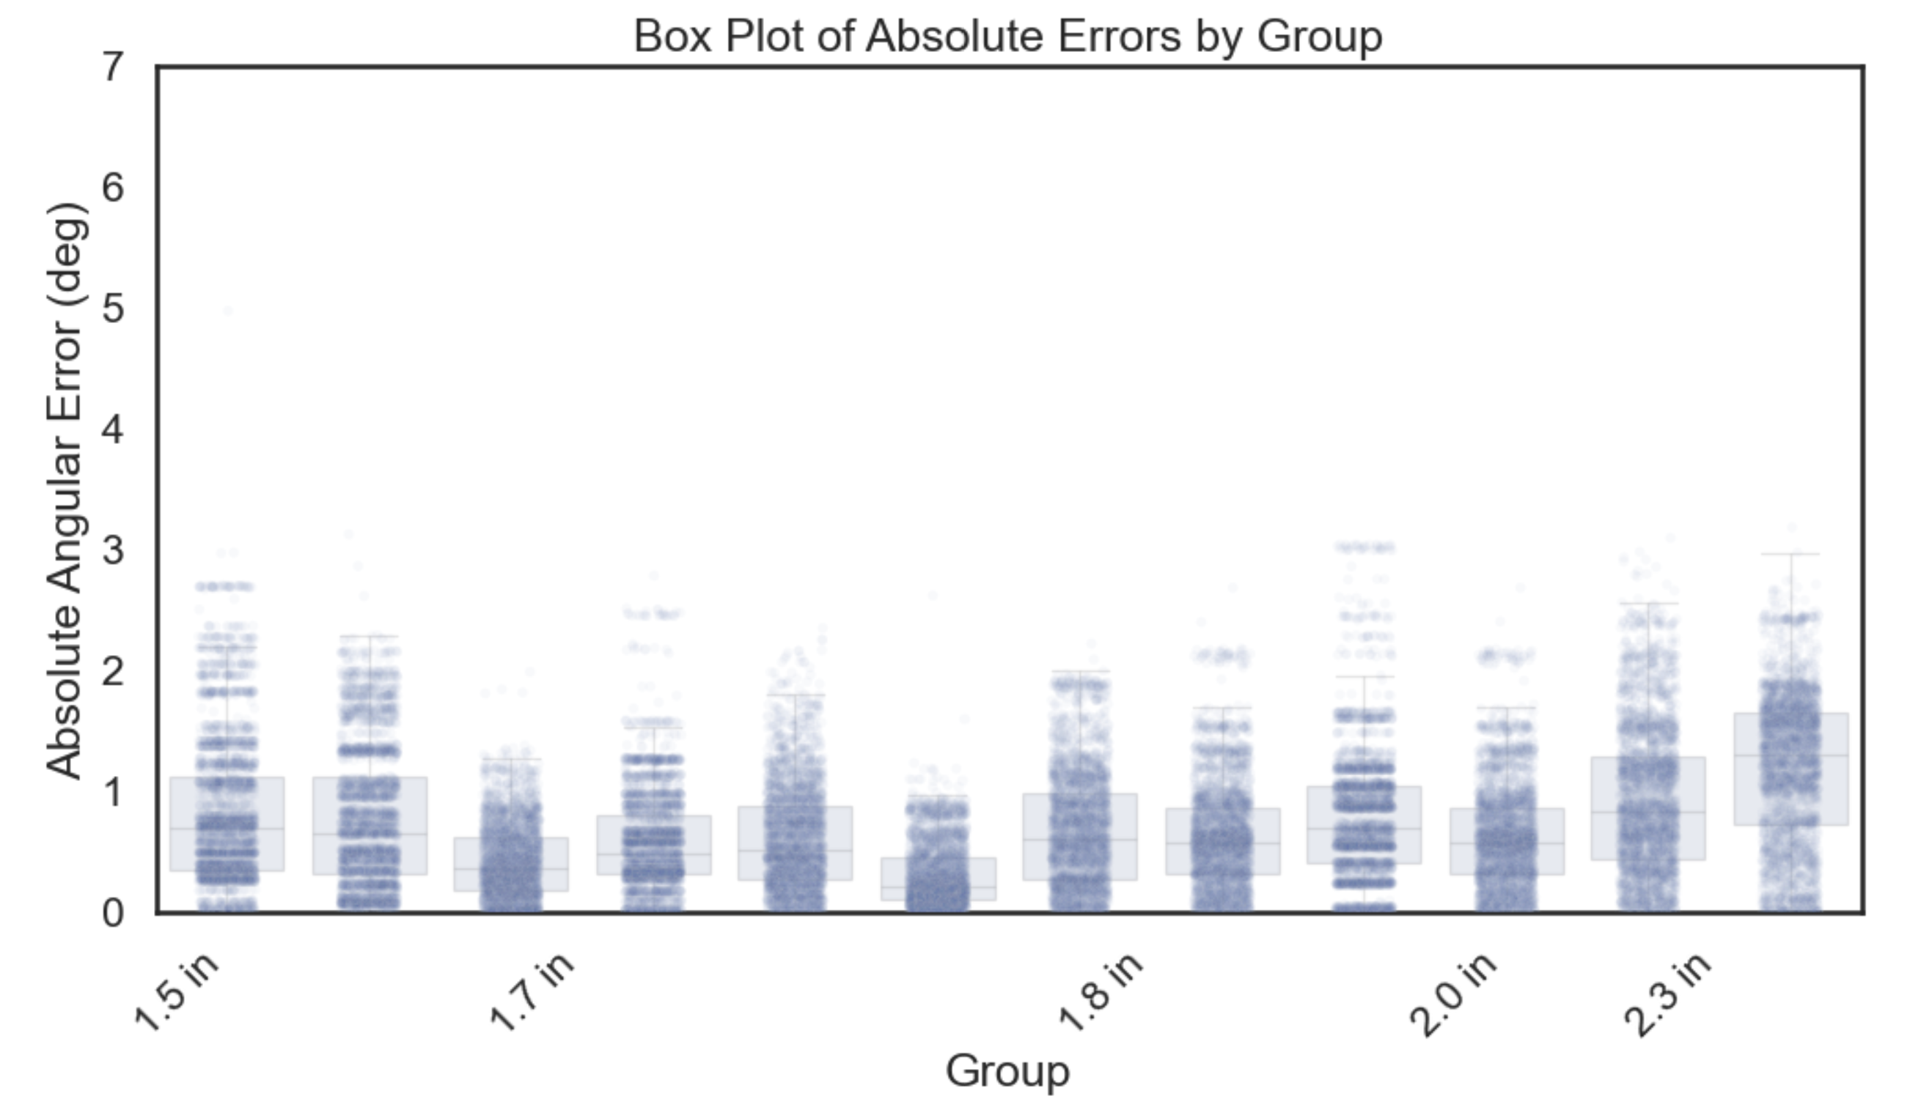
Linear Fitting
Quadratic Fitting

Slide 18
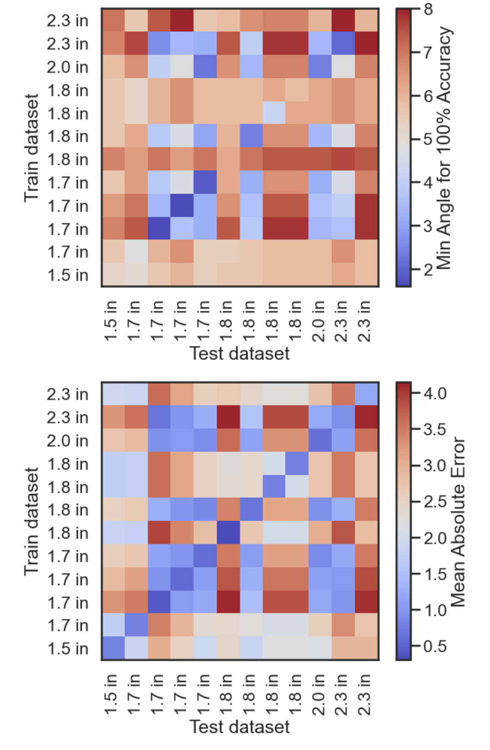
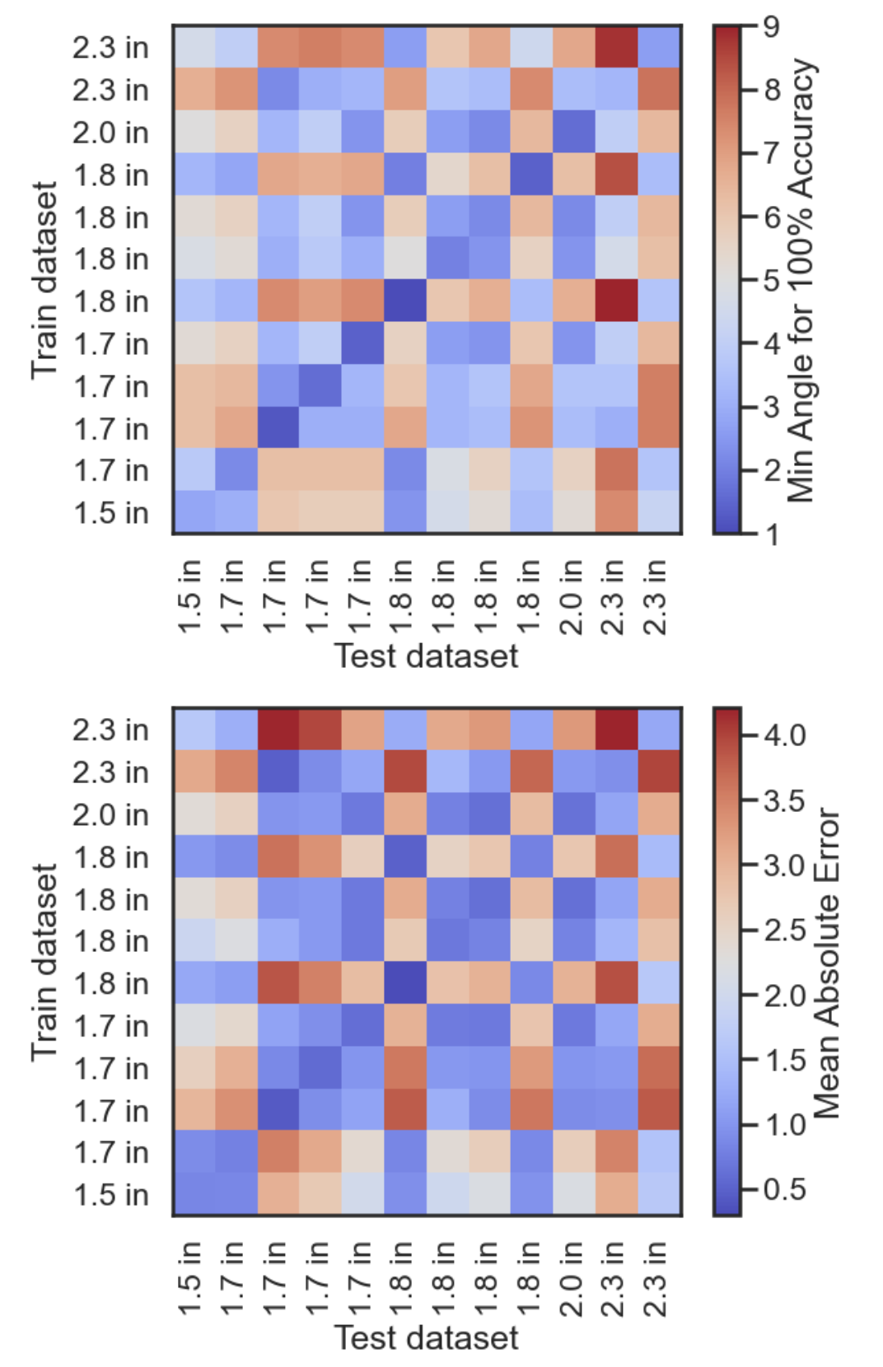
Linear Fitting
Quadratic Fitting

Slide 19
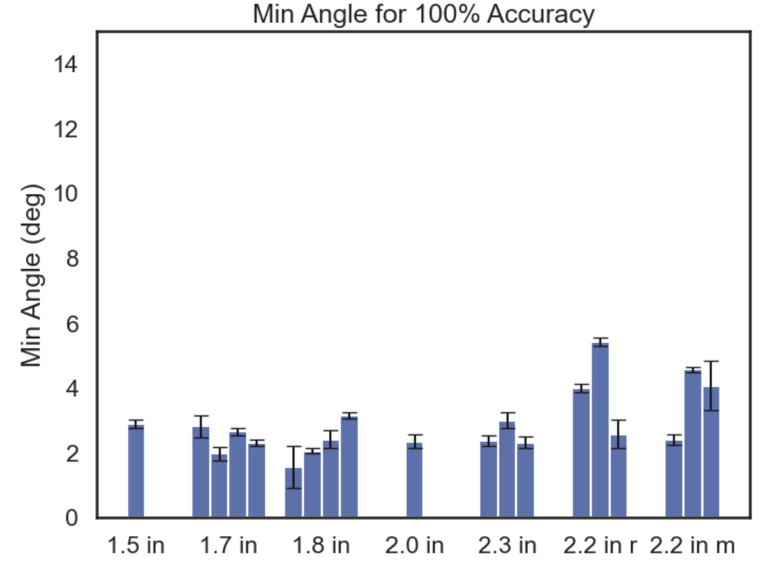
Velcro misalignment
Velcro reapply
0 , 10, 20 deg
Silicone Glue to Bender
v
Same Sample

Slide 20
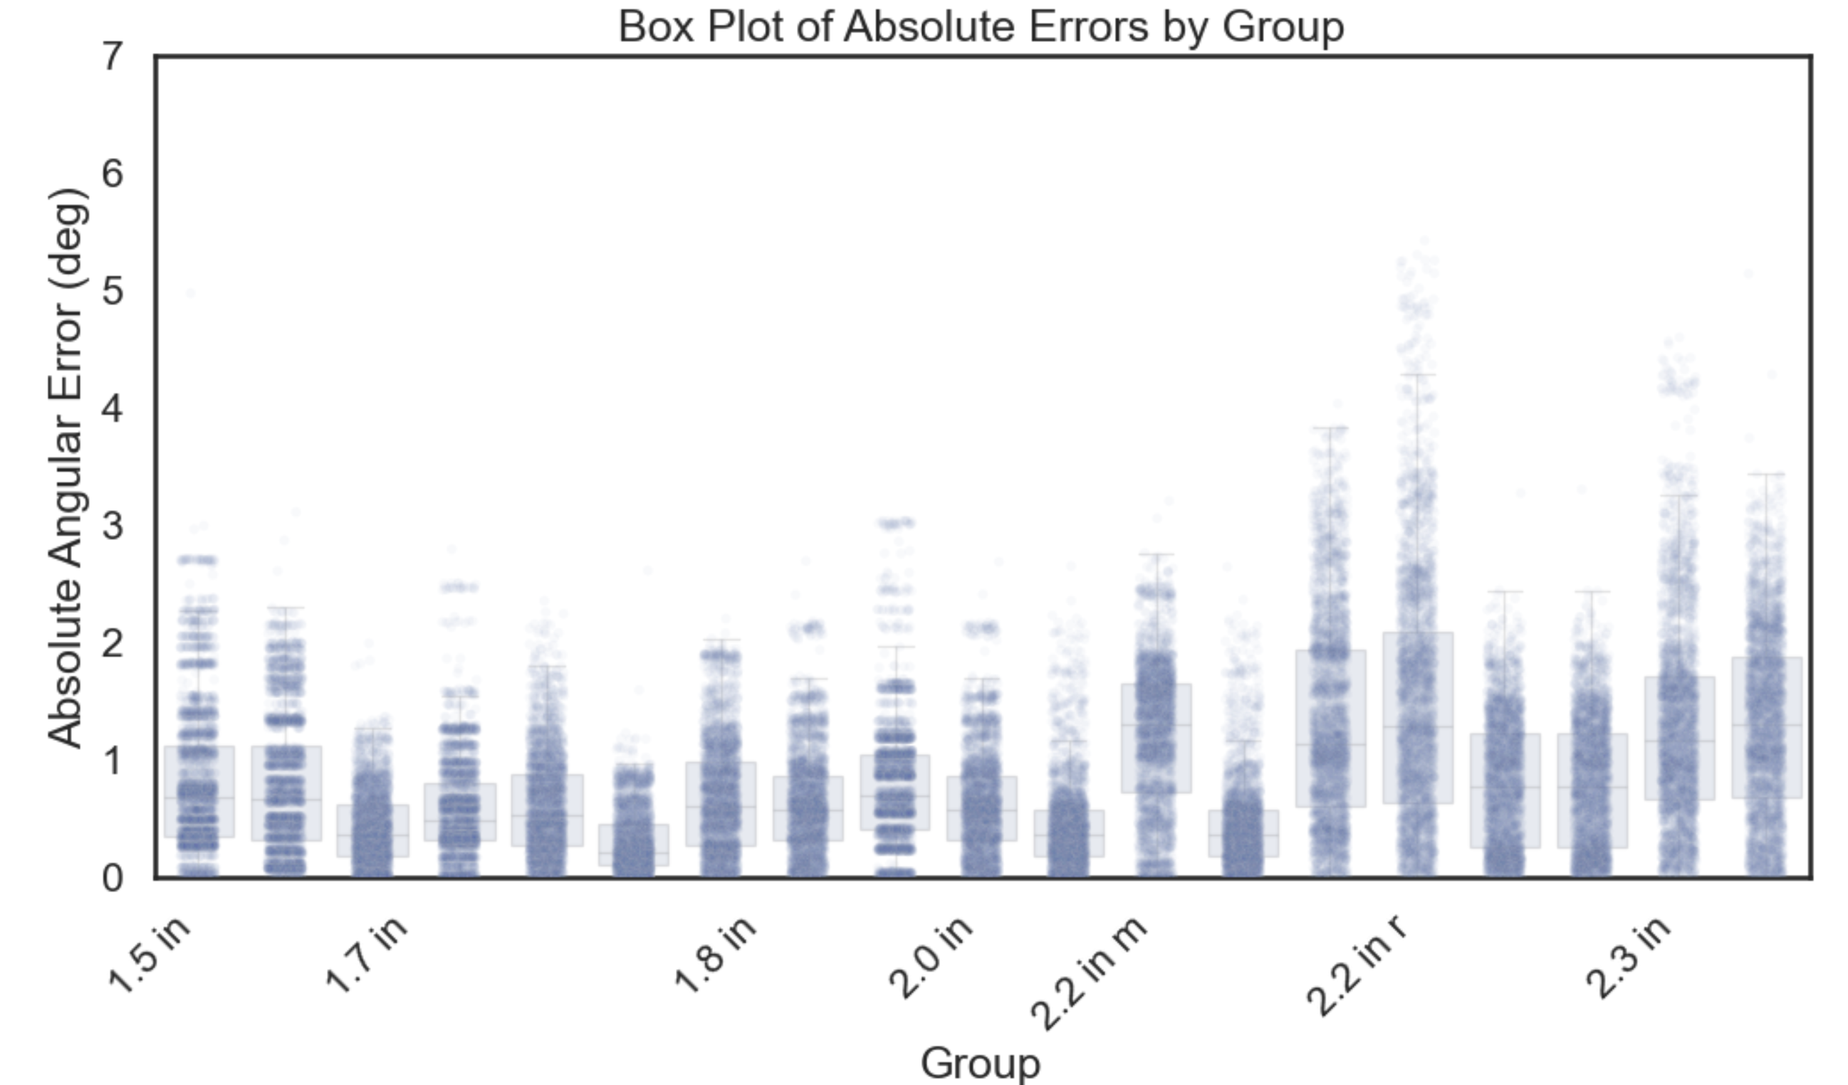
Velcro
v
Same Sample

Slide 21
Kinematics Presentation Tom
4_22_25

Slide 22
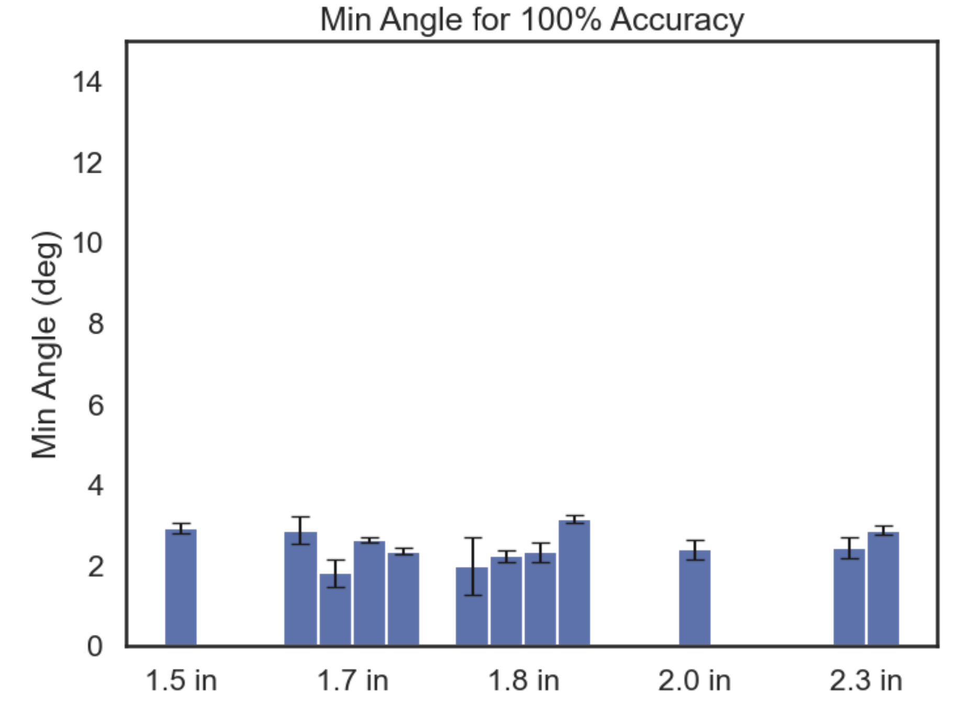
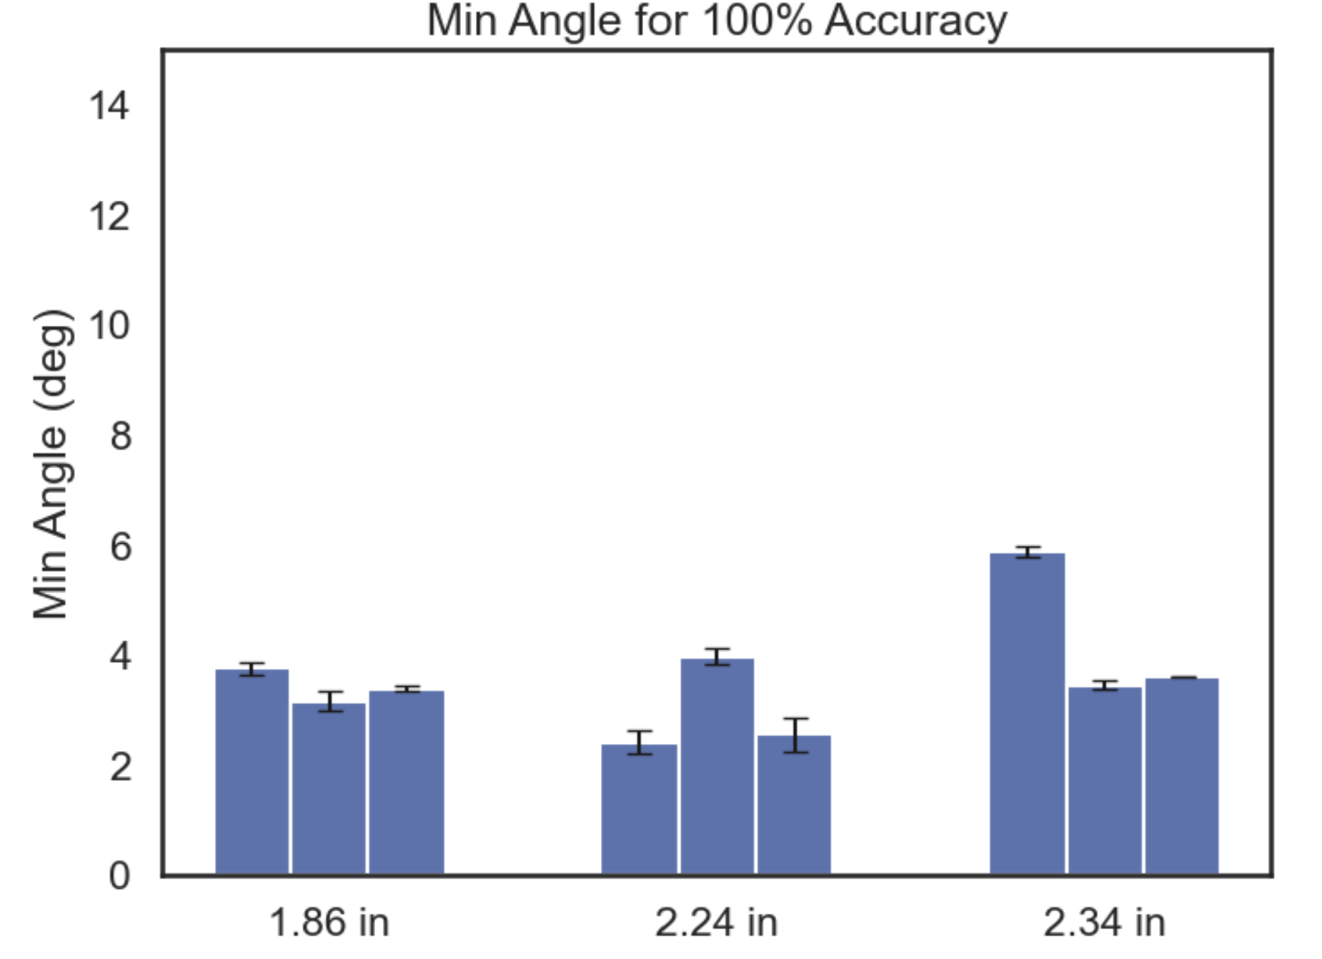
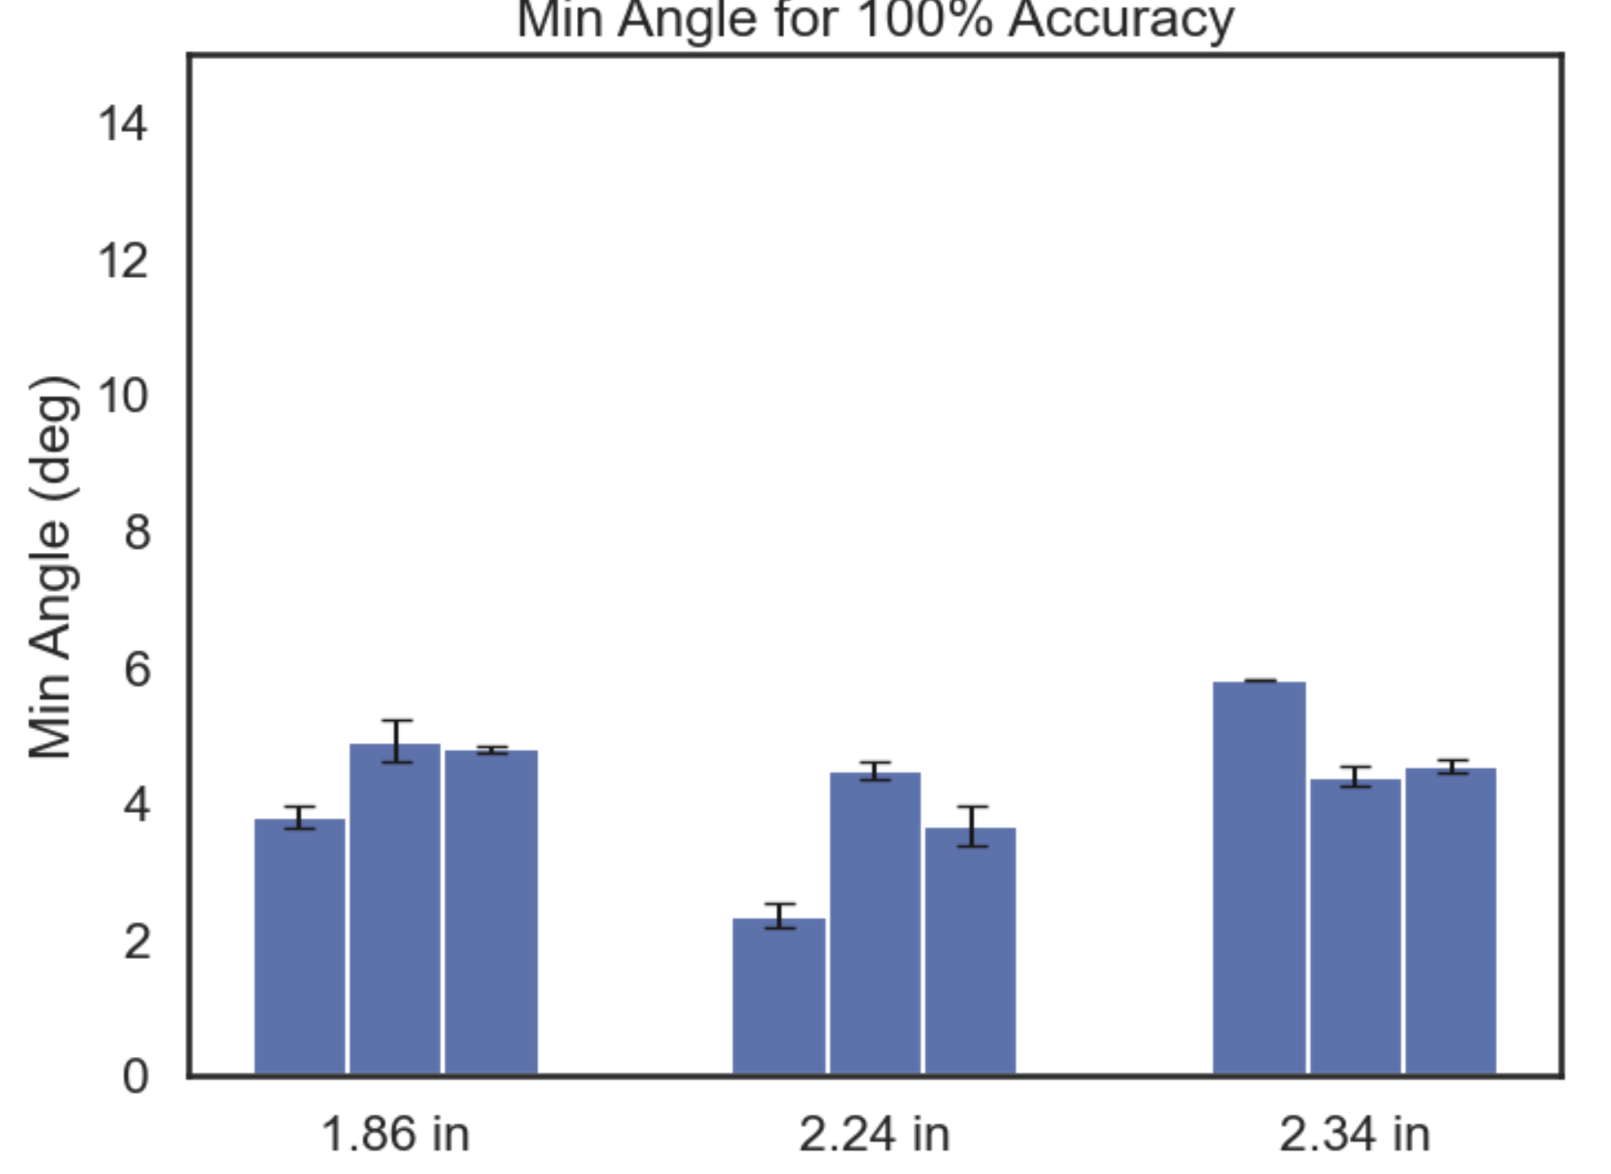
Different Length Samples Norm 0 to 1
Reapplication Data Norm 0 to 1
Misalignment Data (0, 10, 20 deg) Norm 0 to 1

Slide 23
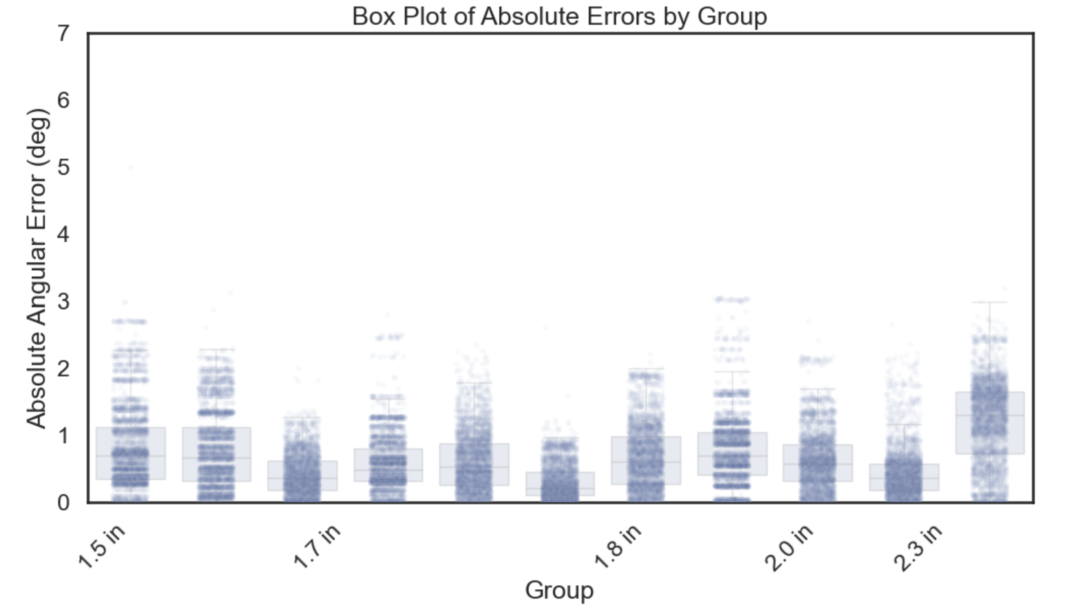
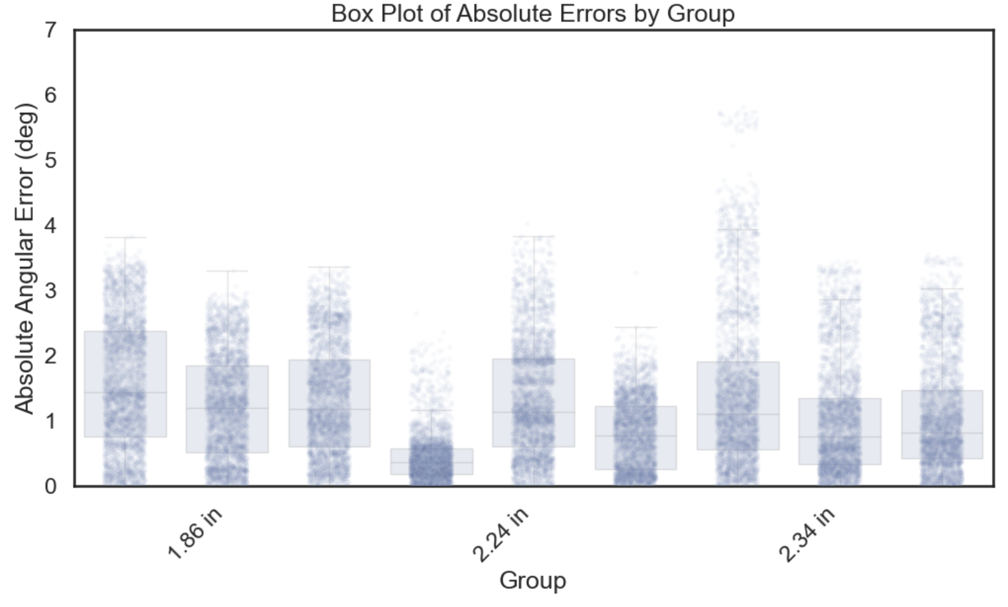
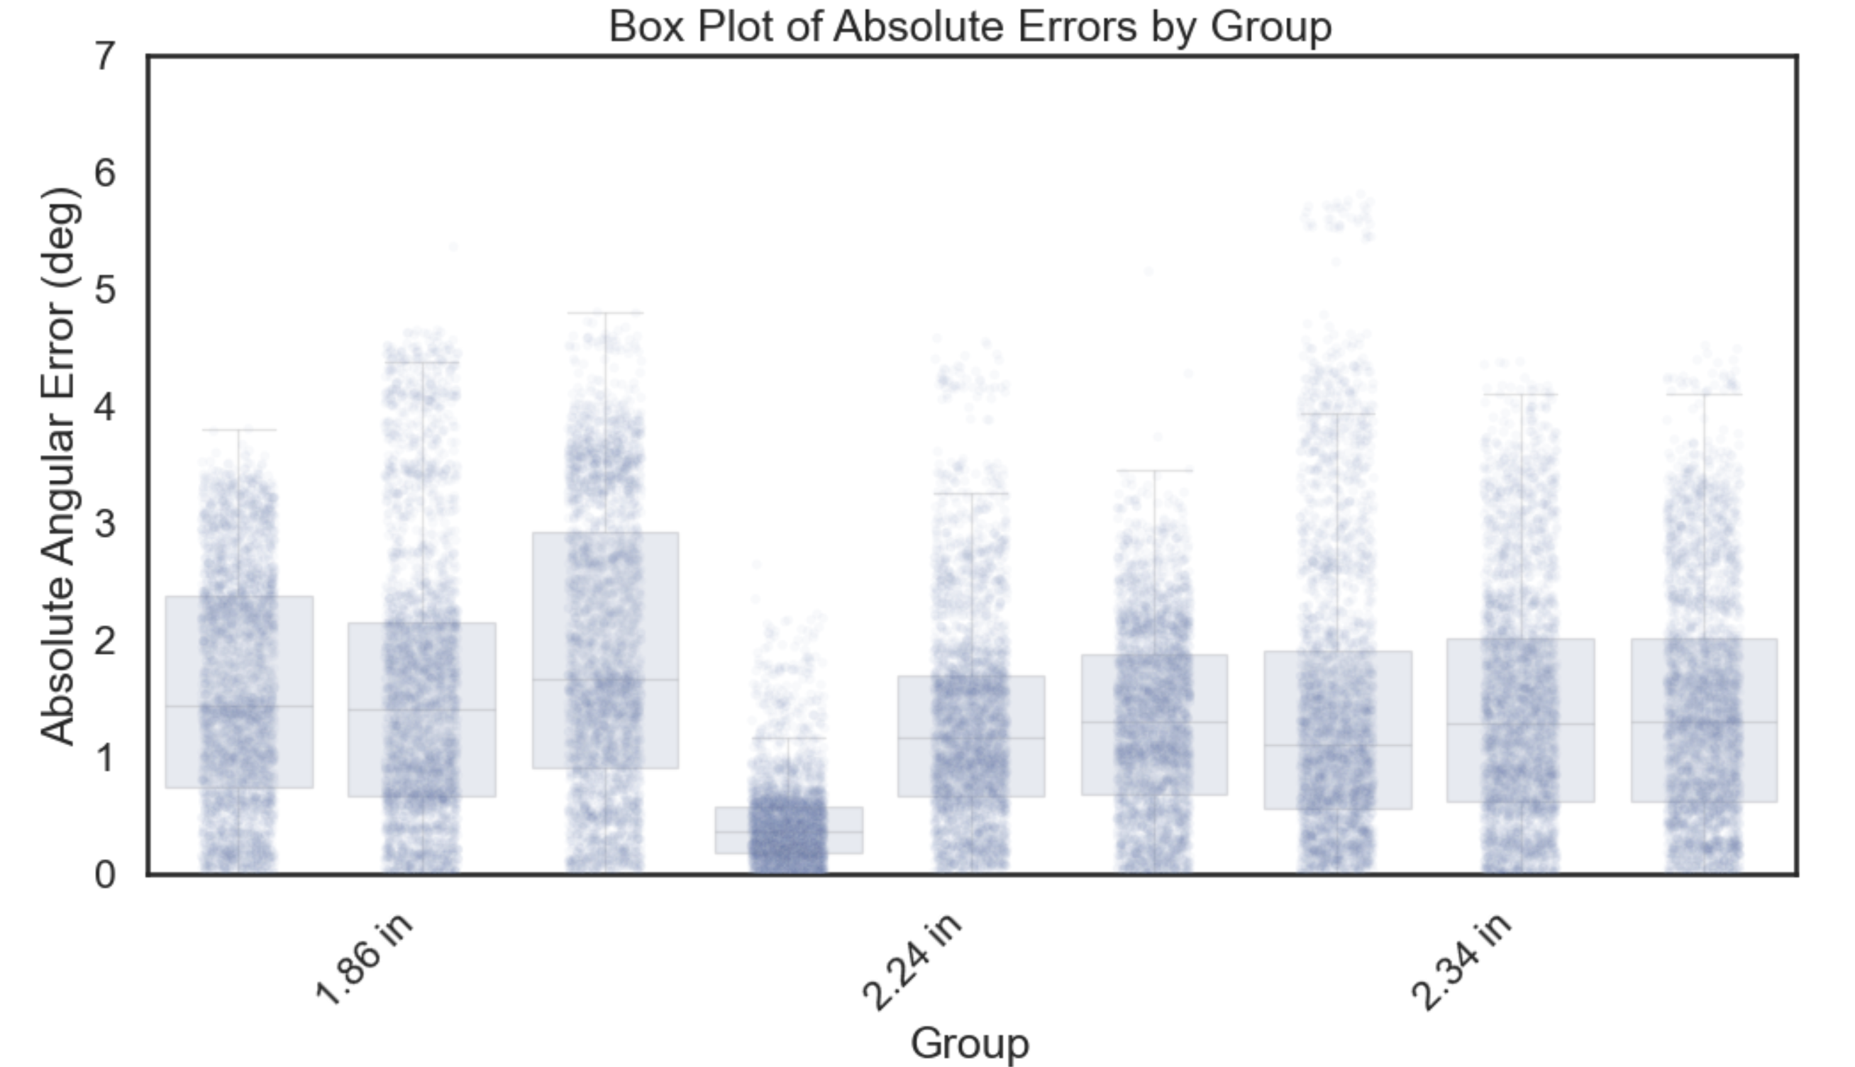
Different Length Samples Norm 0 to 1
Reapplication Data Norm 0 to 1
Misalignment Data (0, 10, 20 deg) Norm 0 to 1

Slide 24
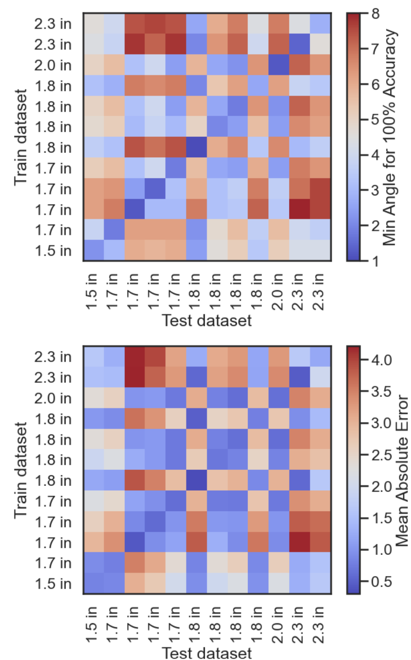
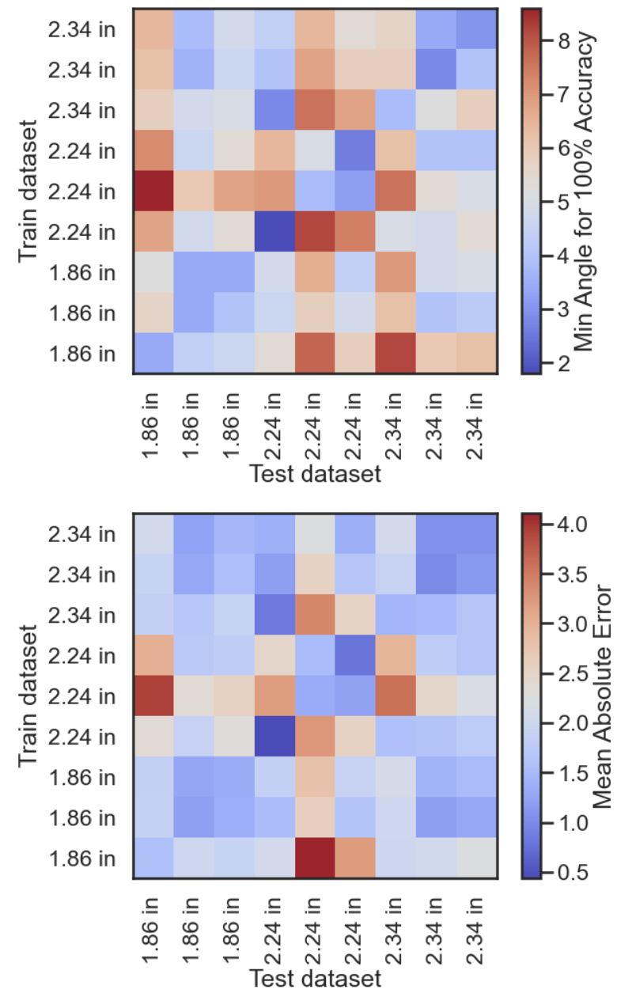
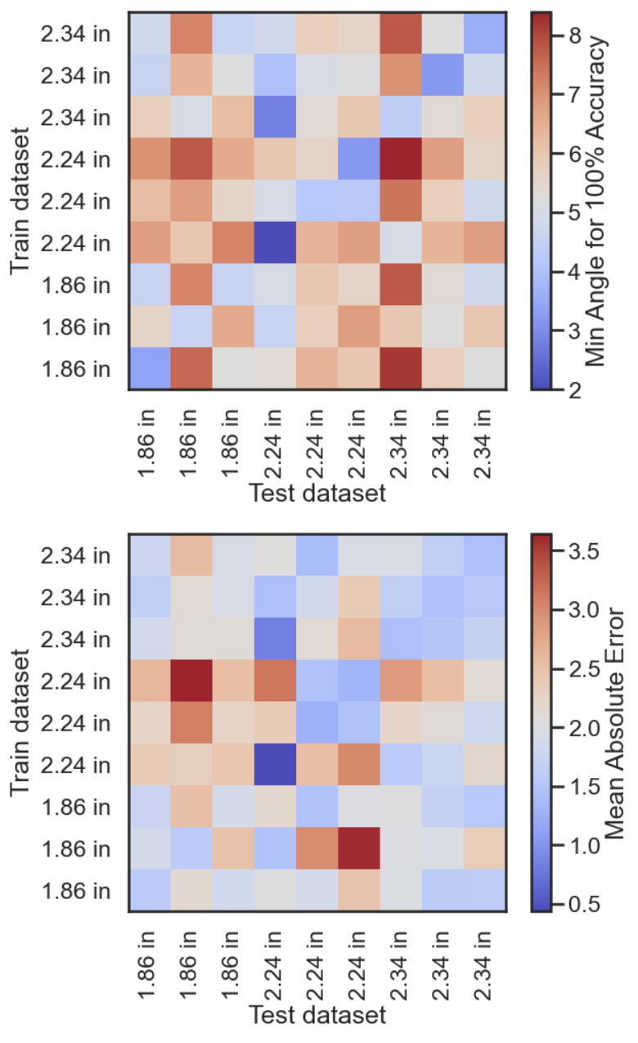
Different Length Samples Norm 0 to 1
Reapplication Data Norm 0 to 1
Misalignment Data (0, 10, 20 deg) Norm 0 to 1

Slide 25
Circuit V1 Option
50 ohm
Strain Gauge (0.4 ohm – 0.8ohm)
LVR +3.3V
+26 mV to 52 mV
+0 mV
GND
x76
LMC6482, 75kohm/1kohm, total gain of 76
LM040, 2.048V ref
GND
+1.98 V to 3.95V
-2.048 V
x2
MCP3421 Differential Input PGA x2, 16 bit
(Alternative can use ADS111)
Arduino Uno I2C
ADC bits range from ~ -3000 to 20000 (as opposed to 5000 delta previously) of possible -32k to 32 k

Slide 26
Latest circuit does NOT have any RF filtering on opamp output
Actual Strain gauge about a foot away from this circuit
1 uF
1k ohm
50 ohm
LVR 3.3 V from 5V Arduino Uno
10 uF
0.1 uF
5V Arduino uno source

